Slide 1
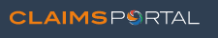
User Guide Multi Factor Authentication (MFA)
28th May 2024
Confidential

Slide 2
Table of Contents
Administrators:
How to add MFA details to a User profile page 3
2. User: How to use email as MFA page 4
- Verify email
- Request token
3. Administrators: page 8
How to add Mobile MFA to a User profile
4 User: page 9
- Verify Mobile number
- Request token
Confidential

Slide 3
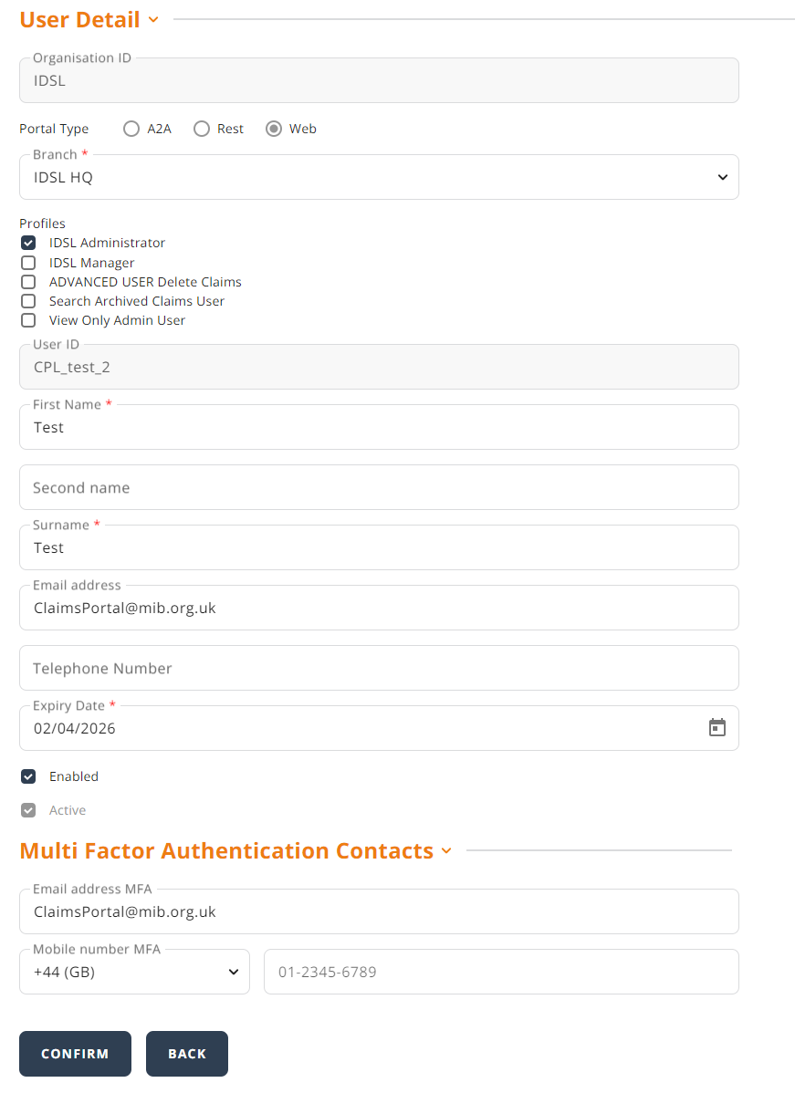
Administrators: How to add MFA details for Users
Before a User can access the Portal, the Administrator needs to ensure that the Multi Factor Authentication Contacts are up to date. Once logged on to the Admin console, update Multi Factor contacts for User

Slide 4
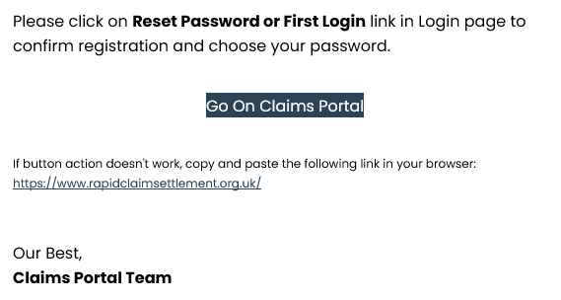
User next steps:
Once the Administrator has confirmed the User’s email address, the User will have to verify their email address.
An email is sent from noreply@rapidclaimsettlement.org.uk to prompt the User to validate their email address:

Slide 5
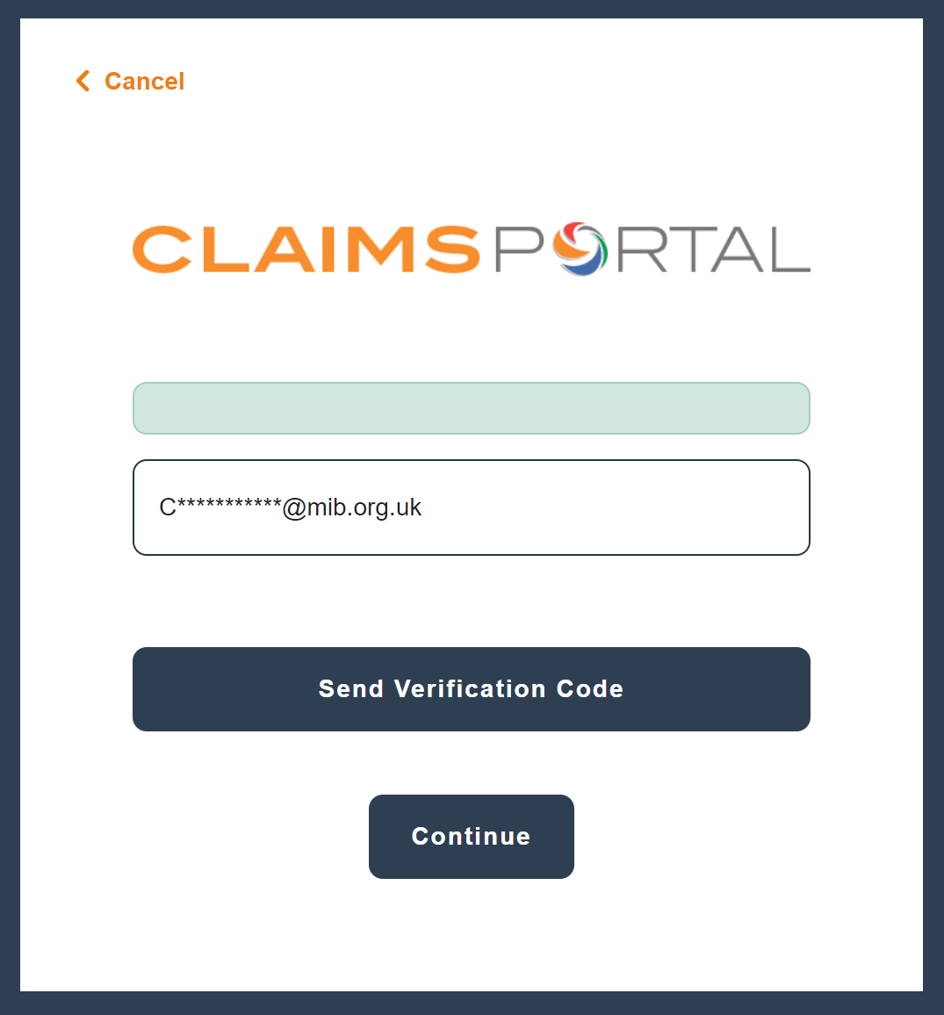
User next steps:
When the User logs on to the Portal, they will be prompted to click ‘Send Verification Code’ to receive a token

Slide 6
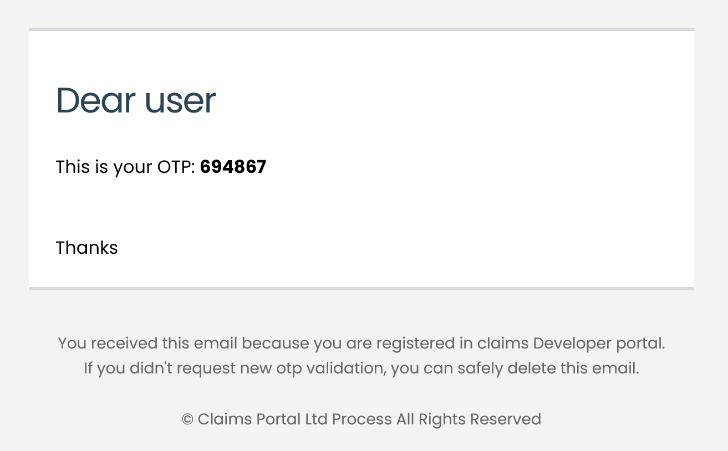
User next steps:
An email is sent from noreply@rapidclaimsettlement.org.uk with a token which expires after 5 minutes

Slide 7
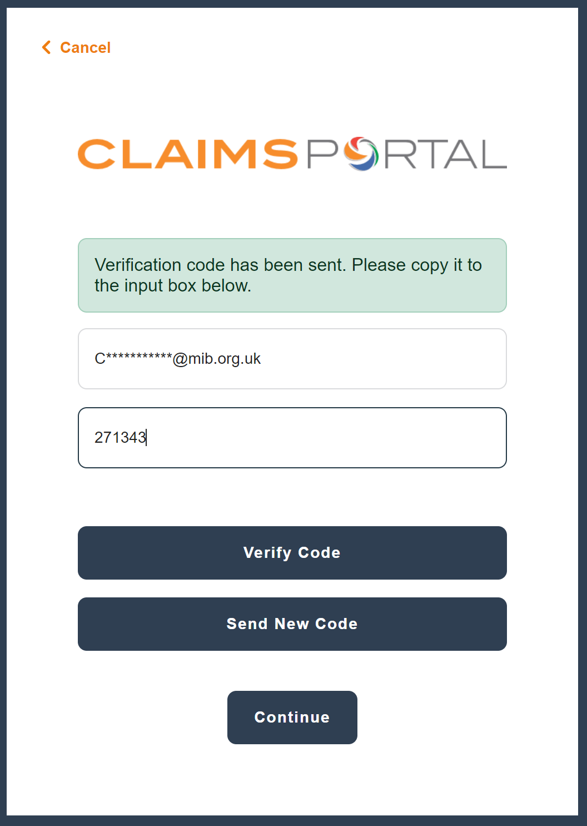
User next steps:
User enters the token and clicks ‘Verify Code’ and can access the Portal.

Slide 8
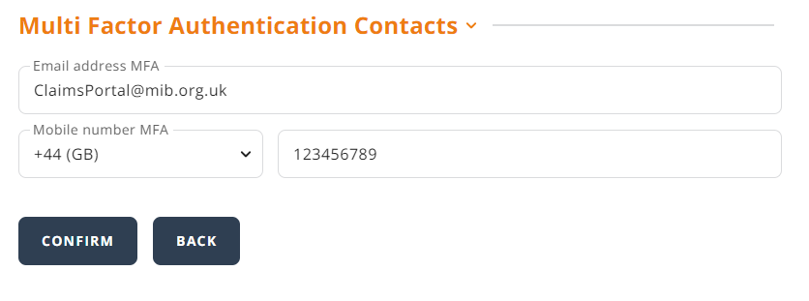
Administrator set up User Mobile:
If a User would prefer to receive the MFA token via SMS text message, they will need to enter the user's mobile number and click ‘Confirm’

Slide 9
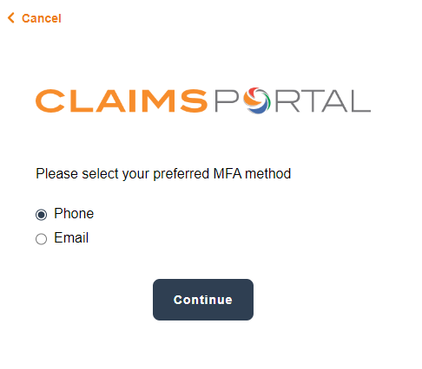
User next steps:
When the User logs on to the Portal they will see the below screen. Choose the relevant option and select ‘Continue’

Slide 10
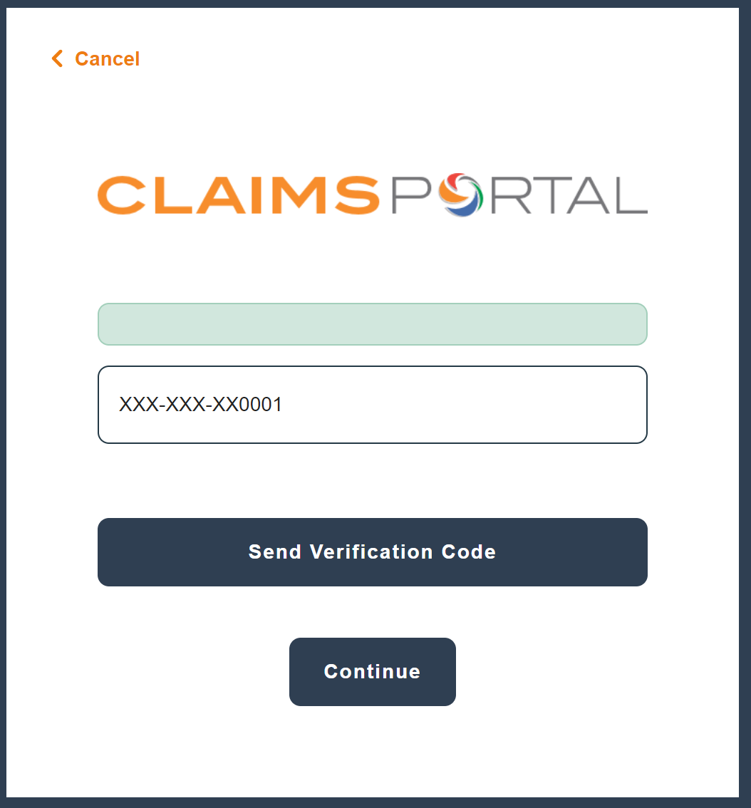
User next steps:
If the mobile number is correct, the User will then click ‘Send Verification Code’

Slide 11
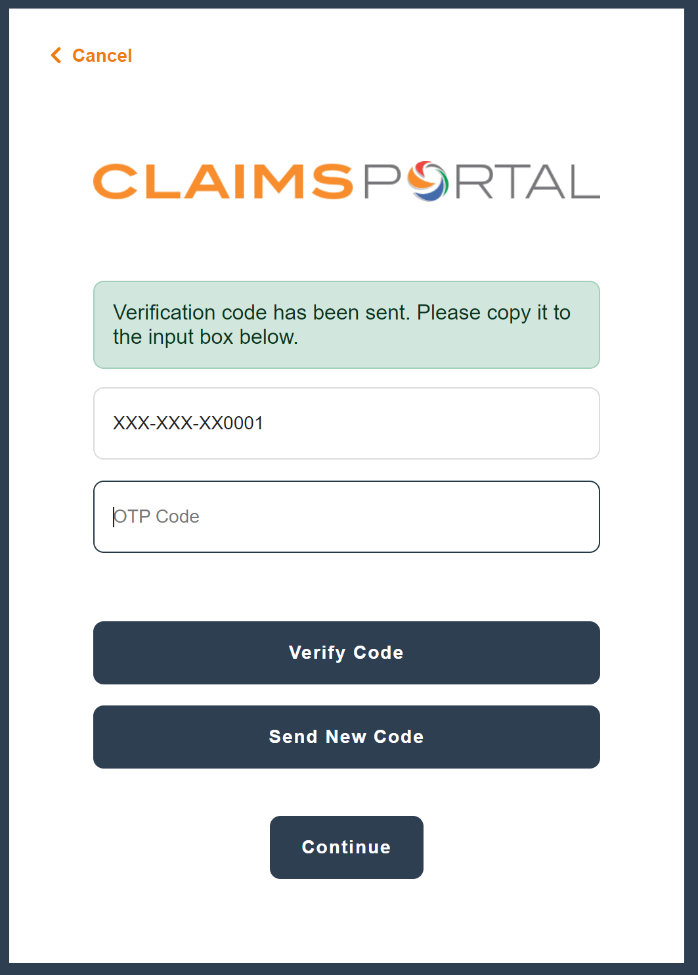
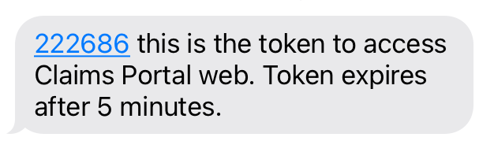
User next steps:
After receiving the SMS Token, the user should enter the code and click ‘Verify Code’
The User will receive an SMS text from C.Portal and have 24 hours to validate their mobile number:

Slide 12
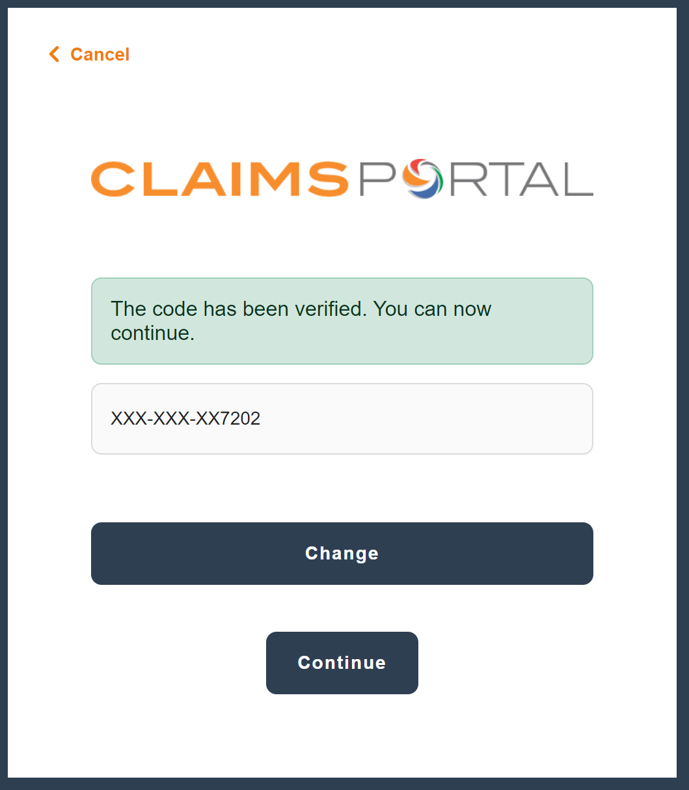
User next steps:
Once the code has been verified, the user will need to click ‘Continue’ .

Slide 13
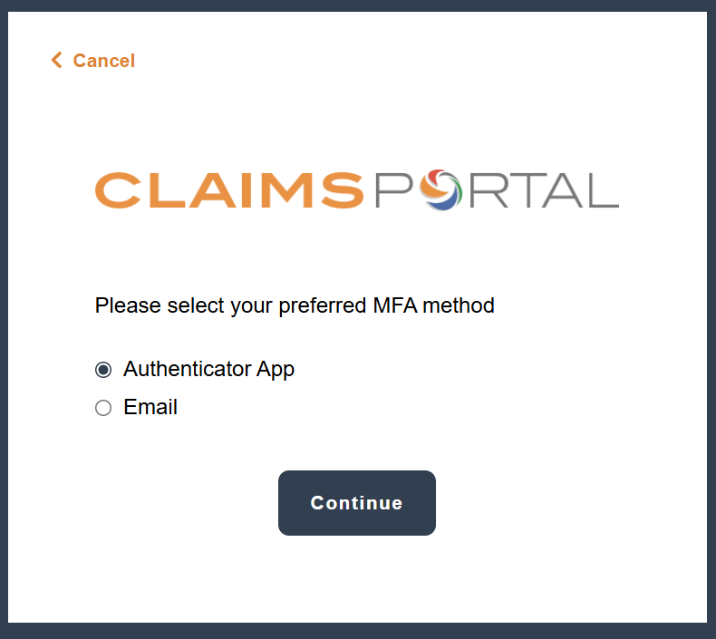
Authenticator App:
Once you have set up your password, you will be given the option to log in using email MFA, or the Authenticator app on your mobile phone.

Slide 14
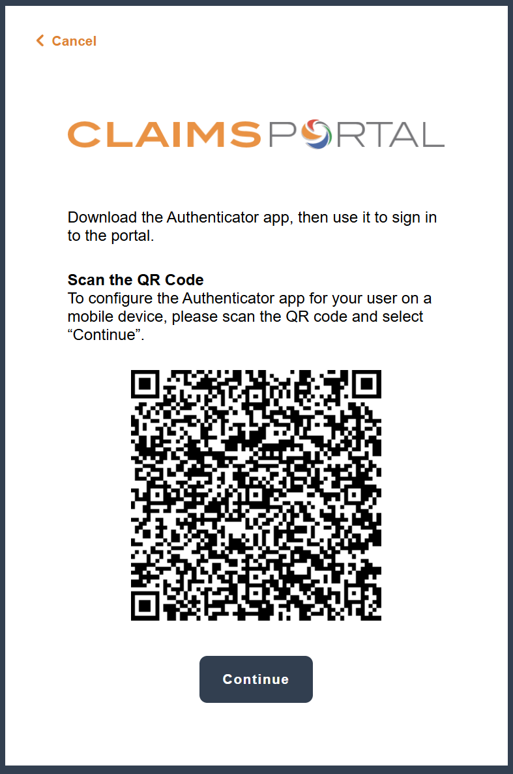
Authenticator App:
If you select the Authenticator app for the first time, a QR code will be generated, which you will need to scan on 'Microsoft Authenticator'

Slide 15
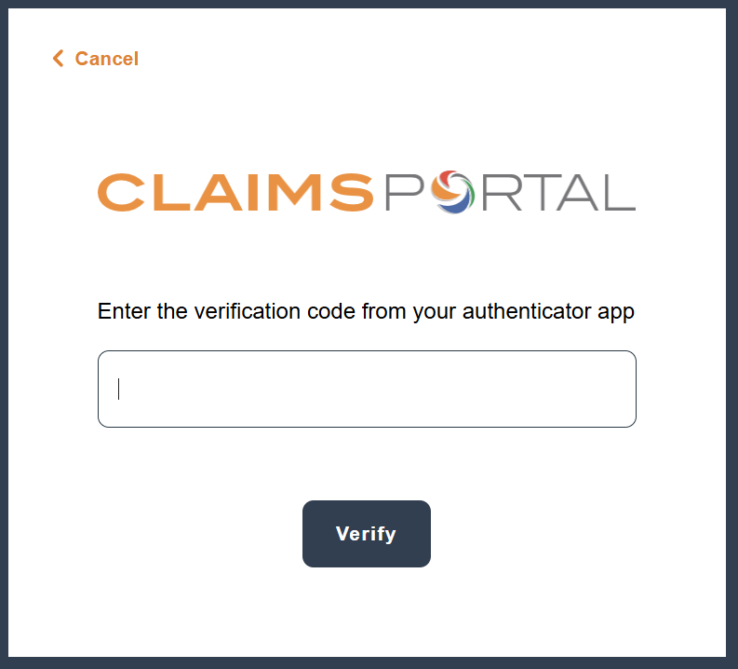
Authenticator App:
Once you have scanned the QR Code, a 6-digit code will be generated and shown on your app, you will then enter this on the next page, which will allow log in.

Slide 16
Authenticator App:
After this initial process, when you go to log in to the web portal going forward, the option to use the authenticator will automatically appear, and will allow you to type the code which will appear on the app.
The authenticator app will be the quickest and preferred method available.

